Slide 1

Web Scraping and Job Filtering Platform
TEAM MEMBERS
ABIN THOMAS
GEETHU SAMEELA

Slide 2
Aim
The primary goal of this project was to create a platform that scrapes job listings from websites, displays all available jobs, and provides specialized filtering options for Python and PHP jobs.
Why this project? Many job platforms lack advanced filtering for niche technologies like Python and PHP, resulting in a tedious job search process for developers.

Slide 3

Hypothesis
Automating job data scraping and presenting it via a user-friendly interface can significantly enhance job searches, particularly for specific technologies like Python and PHP.

Slide 4
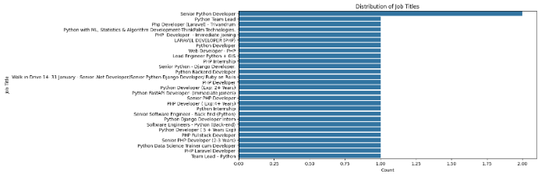
Data Analysis

Slide 5
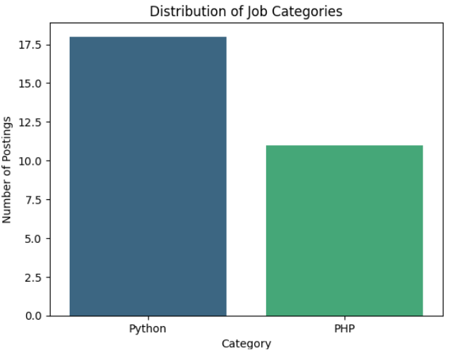
CONTI..

Slide 6
Method
Tools & Technologies:
Web Scraping: BeautifulSoup and Selenium for data extraction.
Back-End: Flask for serving data.
Front-End: HTML, CSS, JavaScript for an intuitive interface.
Database: CSV for storing scraped data.
Process:
Scrape job listings from target websites.
Parse and store relevant details like Job Title, Company, Location, Salary, and Job Type.
Develop filters for Python and PHP jobs.
Dynamically display data on a web application.

Slide 7
Problems Faced
Dynamic Content:
Many job listing sites use JavaScript to load data, requiring Selenium for dynamic scraping.
Data Structure:
Inconsistent job details led to parsing challenges.
Design Challenges:
Crafting a clean and user-friendly interface while ensuring efficient data display.

Slide 8
Solutions
Dynamic Content:
Used Selenium to simulate browser interactions and extract dynamically loaded data.
Data Cleaning:
Incorporated validation checks to handle missing or malformed data.
Front-End Design:
implified the user interface using Flask's Jinja2 templating engine and responsive CSS.

Slide 9
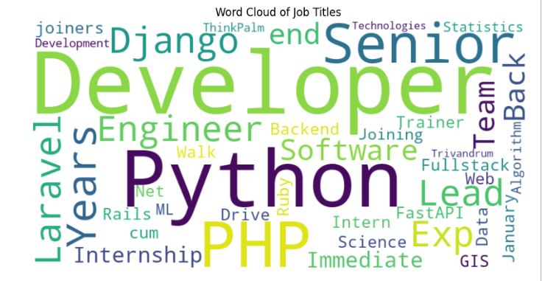
Conclusion
Key Takeaways:
Web scraping streamlines the job search process.
Filtering Python and PHP jobs saves time for job seekers.
Selenium handled dynamic scraping challenges effectively.
Future Scope:
Add advanced filters (e.g., location, experience).
Integrate APIs for real-time updates.
Deploy the platform online for public access.

Slide 10

Demo (Results)

Slide 11

THANK YOU

